Slide 1
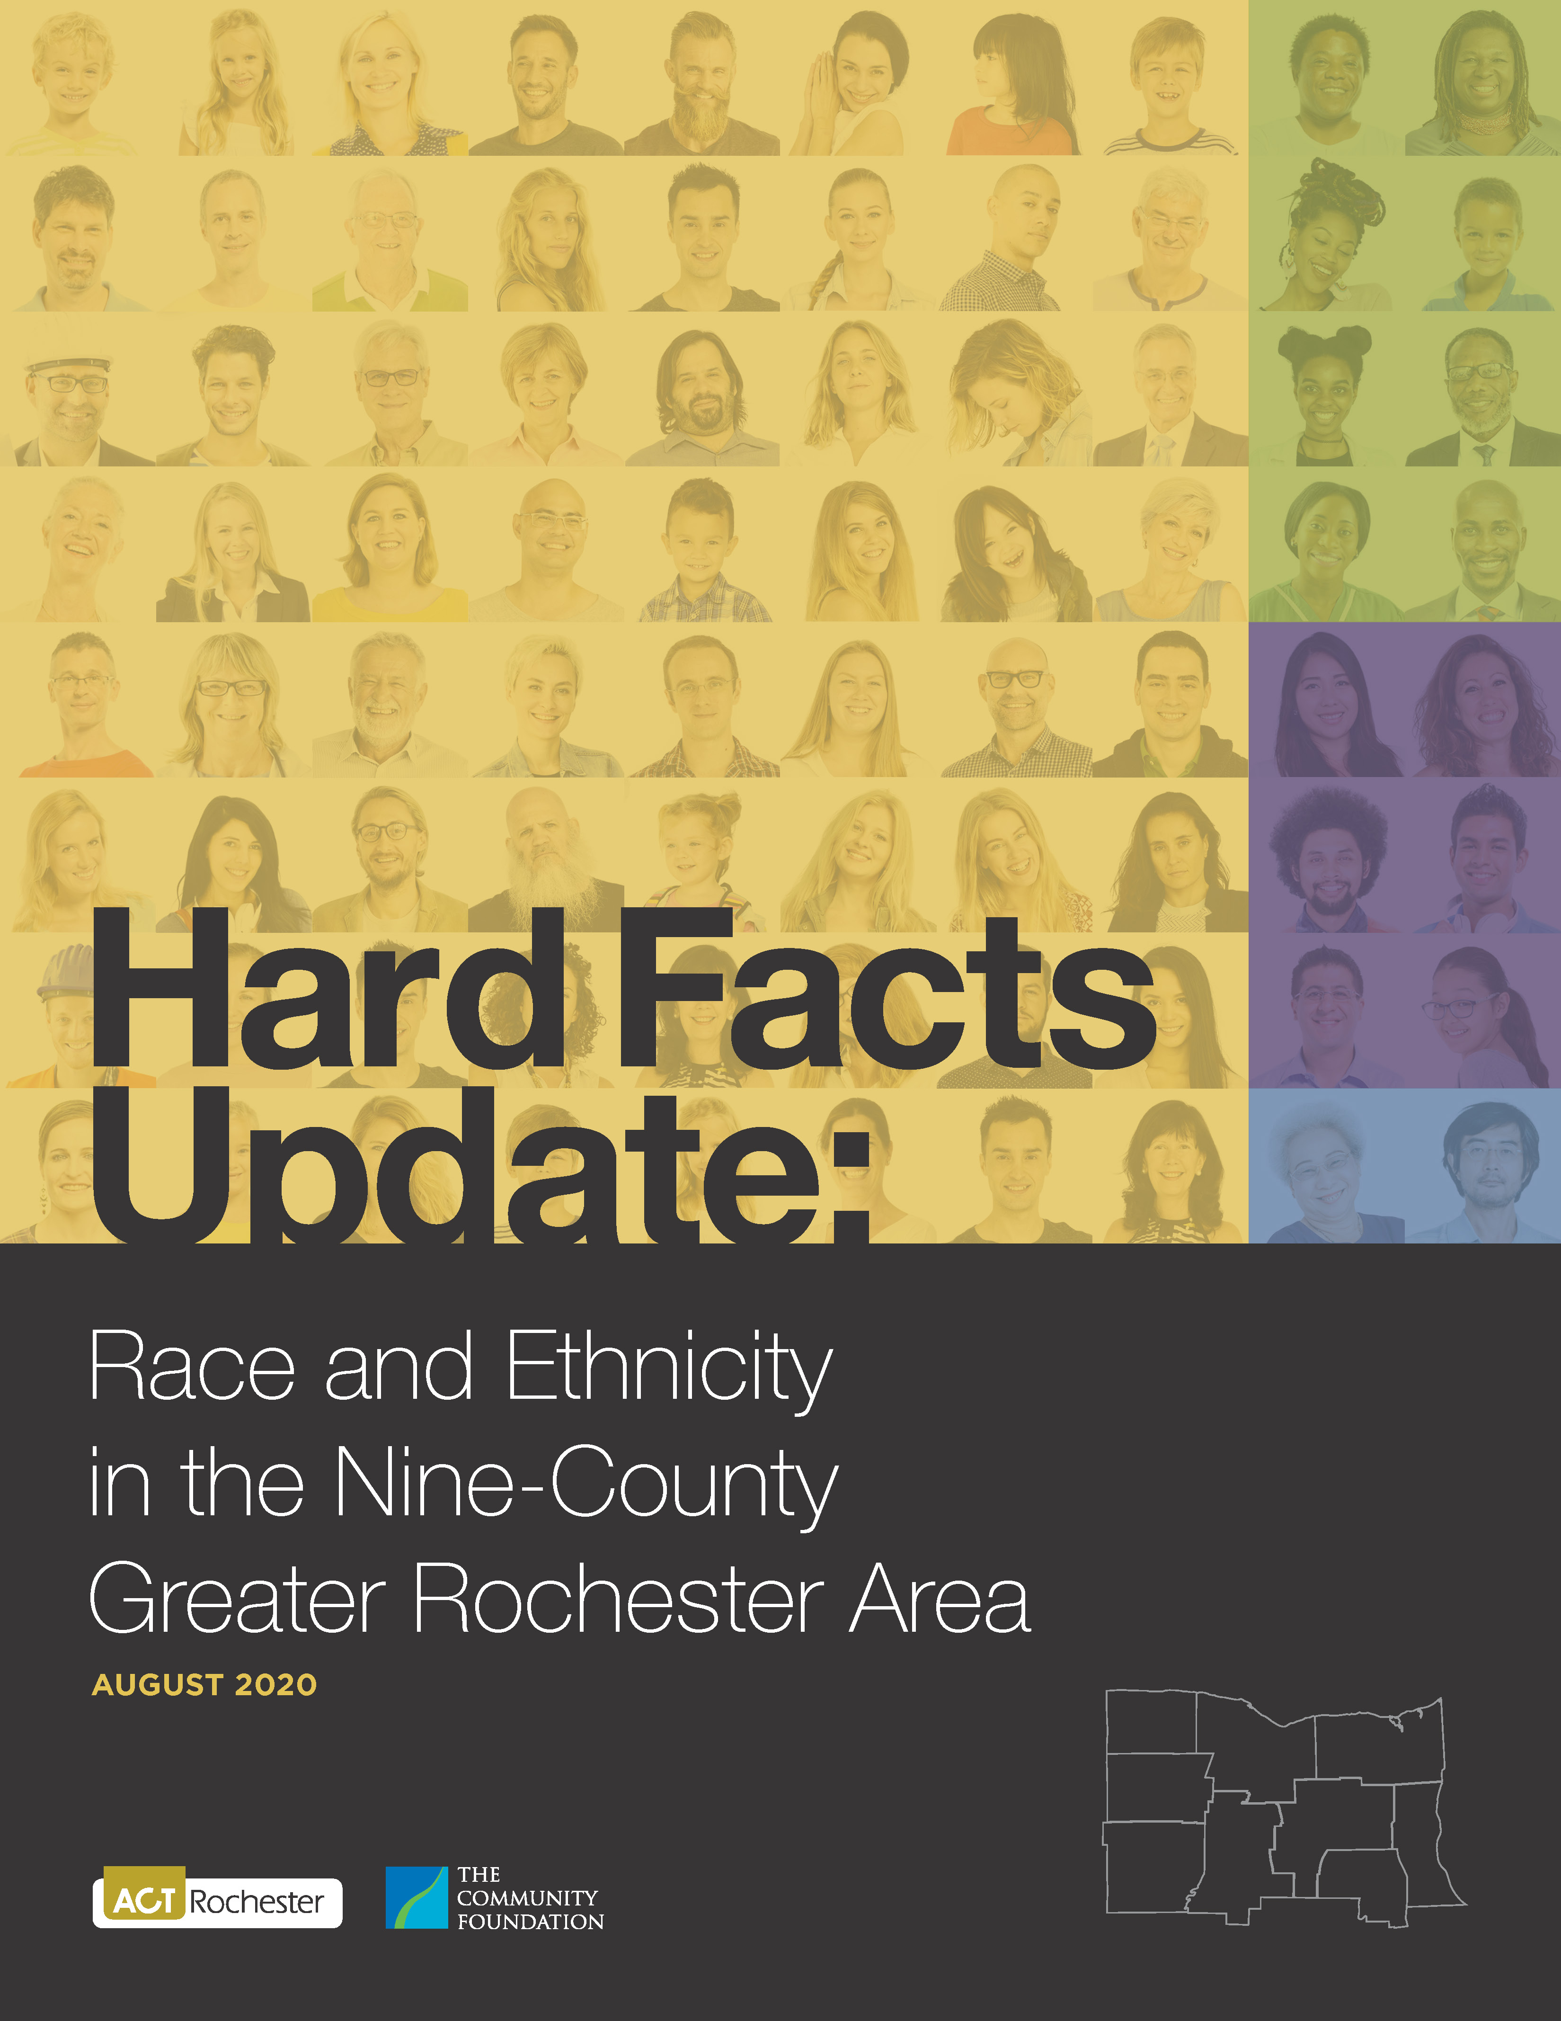
Hard Facts
2020

Slide 2
Hard Facts 2020
Content of this Presentation
Content | Slide Number (s)
Cover | 1
Contents | 2
Purpose and Method of Report | 3-5
Summary of Findings | 6
Details: Inequalities within the Region | 7-14
Details: Comparing the Region with the U.S. and New York State | 15-21
Some Conclusions to Ponder | 22-24
Some Probing Questions | 25-28

Slide 3
Hard Facts 2020
Why this report?
To create a deeper knowledge of the inequalities faced by people of color in the nine-county Rochester region*
To stimulate conversations leading to fuller understanding and community action
A Process for Community Change:
Knowledge
Understanding
Action
* The nine-County region includes: Monroe, Wayne, Ontario, Seneca, Yates, Livingston, Wyoming, Genesee, and Orleans

Slide 4
Hard Facts 2020
Method: Two Basic Questions
How do the outcomes for African Americans and Latinos compare with Whites within the nine-county Rochester region?
How do the outcomes for African Americans and Latinos in the nine-county Rochester region compare with those for People of Color nationwide and in New York State?
Gaps among racial
and ethnic groups
within the region
Gaps
between
our region
and the U.S. and/or
NY State

Slide 5
Hard Facts 2020
Why the emphasis on African Americans and Latinos?
The nine-county regional population is more than 82% White.
The 128,400 African Americans in the region account for 10.8% of the population, and are, by far, the largest minority group.
The region’s 81,600 Latina/Latino residents account for 6.8% of the total population.
The disparities experienced by these two groups are very similar and are dramatic.
While there are other minority groups, they are relatively small in number. Asians, the next largest group, account for 2.6% of the regional population.
Note: For those interested in greater detail, Appendices A & B contain full breakdowns by groups for each County.

Slide 6
Hard Facts 2020
Key Findings of the report:
Disparities impact individuals and families throughout their lives, and even into future generations. Wide gaps exist in all measures.
The gaps between racial and ethnic groups are greater in the Rochester region than in the United States or New York State as a whole.
These results have a demonstrable impact on the well-being of the Rochester region.

Slide 7
Hard Facts 2020
Inequalities within the region – Child Health and Well-being:
African Americans are 2½ times more likely than Whites to give birth to low-weight babies; Latinos are twice as likely (data is available for Monroe County data is available for Monroe County only).
For infant mortality, African American children are 3 times more likely to die before age one than Whites, while Latino children are about twice as likely (data is available for Monroe County only).

Slide 8
Hard Facts 2020
Inequalities within the region – Child Health and Well-being:
African American children are nearly 4 times more likely to experience child poverty than Whites, while for Latino children the likelihood is slightly more than 3 times.

Slide 9
Hard Facts 2020
Inequalities within the region – Education:
For the foundational Grade 3 English Language Arts, the African American passing rate is slightly less than half (48%) that of Whites, while for Latino students it is slightly more than half (52%).

Slide 10
Hard Facts 2020
Inequalities within the region – Education:
For Grade 3 Math, test results were very similar, with a passing rate for African American students equaling 49% of Whites and Latino students at 54%.
Results for Grade 8 English showed a greater gap, with a passing rate for African American students at 35% of the rate for Whites, and Latino students at 42%.
Graduation rates for Students of Color have improved in recent years, and now stand at about 80% of the White rate for both African Americans and Latinos.

Slide 11
Hard Facts 2020
Inequalities within the region – Economic Well-being:
Compared with Whites in the region, African Americans are almost 3 times as likely to experience unemployment, while Latinos are 2 ½ times as likely.
African American incomes are less than half those of Whites (49%), while Latino incomes are only slightly more than half (53%).

Slide 12
Hard Facts 2020
Inequalities within the region – Economic Well-being:
The poverty rates for both African Americans and Latinos are about 3 times that of Whites.

Slide 13
Hard Facts 2020
Inequalities within the region – Housing and Intergenerational Wealth:
Compared with Whites, African Americans are: dramatically less likely to own homes (32% versus 73%); pay a higher percent of income for rent (44% compared with 30%); and, for those who do own homes, realize values that are at only 59% of White homeowners.
For Latinos, the outcomes are similar: homeownership is lower (35% compared with 73%); rent burdens are higher (44% of income versus 30%); and home values are lower (68% of White homeowners).

Slide 14
Hard Facts 2020
Inequalities within the region – Housing and Intergenerational Wealth:

Slide 15
Hard Facts 2020
As shown in the preceding slides, the racial and ethnic disparities within the 9-county region are profound. But in many ways, the disparities between our region and the national and statewide measures (following slides) are even more disturbing. Since the region is a microcosm of the nation, outcomes for African Americans and Latinos should reflect their counterparts, but they do not!
The conclusion is inescapable:
Racial and Ethnic inequalities are a reflection of societal injustice, and that injustice is stronger in the Rochester region than in the nation as a whole, or NY State as whole.

Slide 16
Hard Facts 2020
Comparing the nine-county region to the nation - African Americans are:
More likely to be in poverty (34% compared with 24%);
Have children who are more likely to be in poverty (49%, versus 35%);
More likely to experience unemployment (13.8% compared with 10.6%);
Have lower incomes (75 cents on the dollar compared with the nationwide level).

Slide 17
Hard Facts 2020
Comparing the nine-county region to the nation - African Americans are:
Less likely to own a home (32% versus 42%);
Pay a higher percent of income for rent (44% compared to 35%); and
Own homes of a lower value (less than 50%).

Slide 18
Hard Facts 2020
Comparing the nine-county region to NY State - African Americans students:
Had a lower passing rates for:
Grade 3 English Language Arts (25% compared with 45%);
Grade 3 Math (28% versus 43%);
Grade 8 English (17% compared with 37%).
Had a slightly lower graduation rate (72% versus 75%).

Slide 19
Hard Facts 2020
Comparing the nine-county region to the nation - Latinos:
More likely to be in poverty (32% compared with 21%);
Their children are more likely to be in poverty (40%, versus 28%);
More likely to experience unemployment (10.8% compared with 6.8%);
Have lower incomes (66 cents on the dollar compared with the nation);

Slide 20
Hard Facts 2020
Comparing the nine-county region to the nation – Latinos:
Less likely to own a home (35% versus 47%);
Pay a higher percent of income for rent (44% compared to 32%); and
Own homes of a lower value (about 46%).

Slide 21
Hard Facts 2020
Comparing the nine-county region to NY State – Latino students:
Had a lower passing rates for:
Grade 3 English Language Arts (27% versus 43%);
Grade 3 Math (31% versus 43%);
Grade 8 English (20% compared with 39%).
Had the same graduation rate (75%).

Slide 22
Hard Facts 2020
Some Conclusions to Ponder:
There are real people behind all of these numbers. Instead of “infant mortality rate,” we should imagine the anguish behind an infant death and remember that reality is 3 times as likely for African Americans.
While there may be a tendency to explain away these inequalities as a reflection of general societal ills, the fact that the Rochester region fares more poorly on almost every indicator suggests there is something local that needs fixing!
This matters! Although most people in our regional community do not regularly see the people behind these numbers, it matters deeply for reasons of conscience and pride. But it also matters for the economic well-being of our region.

Slide 23
Hard Facts 2020
Some Conclusions to Ponder:
This matters! We pay a great cost by excluding people. If People of Color here had the same poverty rate as People of Color nationwide this study estimates that there would be nearly 22,000 fewer people in poverty (that’s nearly half the population of the Town of Webster). The bonus in terms of lower costs and higher local tax revenues would be enormous. If People of Color regionally had the same poverty rate as Whites, the region would have nearly 50,000 fewer people in poverty (that’s about the total population of the Town of Irondequoit).

Slide 24
Hard Facts 2020
Some Conclusions to Ponder:
This Matters! Our regional competiveness is at risk. The region as a whole now lags New York State in educational outcomes. The ability of other New York State areas to provide better education outcomes for Students of Color makes those regions more competitive.
This matters! Our regional prosperity is dependent on the contributions of everyone. The individual and social capital that we would generate from fuller participation may seem intangible, but it is very real.

Slide 25
Hard Facts 2020
Some Probing Questions – For Use by the Leader [note to leader: these questions can be raised during the presentation and also be used to stimulate participation during the Q & A session]
General – About the Report
What are some parts of this report that you do not understand? Or don’t agree with? Why?
This report is structured on a regional basis. Do you understand why that is important? Would it have been more helpful if it was presented on a city or county basis? If so, why?
Do you understand the reasons to look at both the disparities within the region and to compare our region to the nation and state?
Are there things that were not in the report that you would have expected to see?

Slide 26
Hard Facts 2020
Some Probing Questions – For Use by the Leader [note to leader: these questions can be raised during the presentation and also be used to stimulate participation during the Q & A session]
About the Findings:
It is a matter of national concern that the child poverty rate for the entire nation is 20%, but for African Americans it is 35%. But how can that rate be so high at 49% in the nine-County Rochester region?
How can it be that the Latino child poverty rate in our region (40%) is similarly out of whack with the nation?
What could account for the region’s African American children testing at 20 percentage points lower than their statewide counterparts on the all-important grade 3 reading assessment? And for Latino children it is 16 percentage points lower?
National leaders ponder the question of why African American incomes are at only 63% of White residents. But what explanation can there be for the fact that in the nine-County Rochester region the corresponding number is dramatically lower at 49%?

Slide 27
Hard Facts 2020
Some Probing Questions – For Use by the Leader: [note to leader: these questions can be raised during the presentation and also be used to stimulate participation during the Q & A session]
About the Findings (continued)
Given our region’s relatively affordable housing, why is the homeownership rate here lower for People of Color compared to the nation as a whole?
Compared to Whites, the value of homes owned by People of Color in our region is only about half (59% for African Americans, 44% for Latinos).
What are some factors that cause this?
What is the immediate impact of this disparity?
What are some long-term impacts?

Slide 28
Hard Facts 2020
Some Probing Questions – For Use by the Leader [note to leader: these questions can be raised during the presentation and also be used to stimulate participation during the Q & A session]
About Causes and Solutions
What are some factors that might contribute to much poorer outcome for People of Color in the Rochester region when compared with their counterparts nationwide (remember: this question is asking about the Rochester area)?
What role did racism play in creating our current outcomes? What role does it continue to play?
When considering solutions:
What are some immediate actions that should be taken?
What are some longer-term actions?
What is the role of individuals in promoting solutions?

Slide 29
Hard Facts 2020
More information, or to download the report:
ACTRochester.org

